Slide 1
ISNS CASE STUDy
With Dr. Norbert Ketskes on Lung Cancer

Slide 2
Medical Disclaimer
The information provided is for educational purposes and is not intended as medical advice, or a substitute for the medical advice of a physician or other qualified health care professional. This is for science and educational purposes only and cannot be used in any aspect for sales or marketing. You should not use this information for diagnosing a health or fitness problem or disease. You should always consult with a doctor or other health care professional for medical advice or information about diagnosis and treatment. This is Confidential. Do not distribute—for scientific educational purposes only.

Slide 4
DR. NORBERT KETSKÉS, MD
Dr. Norbert Ketskés M.D. is one the most acknowledged gastroenterologist in Hungary, specializing in natural and organic nutritional solutions, leading the well-known Primus Labor, a private clinic offering personalized nutritional advices to its patients.
Scientific Adviser of ISNS
Independent Scientific Adviser of Rain International in Europe since 2013
Medical Partner of the Hungarian Olympic Committee since 2015
Member of the Medical board of Hungarian Karate Association since 2015
Leader of the Primus Labor Private Medical Clinic since 2013
Working as a Family Doctor 1999 – 2012

Slide 5
CSISZTU ZSUZSA
Television - Presenter, Anchor, Editor, Journalist and Sports Lawyer, Sport-diplomat
Spokesperson of the Giro d’Italia Grande Partenza, (Road-Cycling World -Tour Championship)
Spokesperson of the FINA (Swimming and Waters poets World Championship)
2022 Vice-President of the Hungarian Sports Journalists’ Association
Member of the Hungarian Olympic Committee Member of the Advisory Board of the Hungarian Olympic Academy
Newly Elected Vice-President of the International Sports Journalists Association, the first female ever in the field from her homeland, and third globally since 1924 (AIPS)

Slide 6
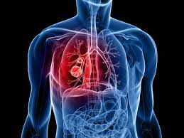
Lung Cancer
Lung cancer begins in the lungs and may spread to lymph nodes or other organs body, such as the brain. Cancer from other organs also may spread to the lungs. When cancer cells spread from one organ to another, they are called metastases.
There are two main types of lung cancer: Non-small cell lung cancer and small cell lung cancer. Each has a separate staging system that doctors use to classify how advanced the cancer is.
Staging helps the doctors predict the likely outlook for a person who has lung cancer. It can also help them develop the best possible plan.

Slide 7
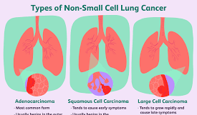
Lung Cancer Types
According to the American Cancer Society (ACS), non-small cell lung cancer (NSCLC) accounts for 80-85% of lung cancer cases. The three main subtypes are:
Adenocarcinoma: Around 40% of people with lung cancer have adenocarcinoma. It usually develops in the outer parts of the lung and tends to grow slower than the other two subtypes.
Squamous cell carcinoma: This type accounts for 25-30% of lung cancer. It grows from the cells that line the inside of the airways. Squamous cell carcinoma usually develops at the center of the lung.
Large cell carcinoma: Around 1—15% of lung cancers are this type. It can grow in any part of the lung and tends to grow faster than other types

Slide 8
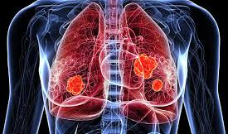
Lung Cancer Types
Small cell lung cancer is a disease in which malignant (cancer) cells form in the tissues of the lung.
There are two main types of small cell lung cancer.
Small cell carcinoma (oat cell cancer)
Combined small cell carcinoma
Smoking is the major risk for small cell lung cancer.
Signs and symptoms include coughing and shortness of breath.

Slide 9
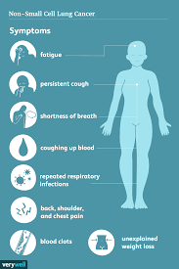
Lung cancer Symptoms
Different people experience different symptoms for lung cancer. Some people have symptoms related to the lungs. Some people whose lung cancer has spread to other parts of the body (metastasized) have symptoms specific to that part of the body. Some people have general symptoms of not feeling well. Most people with lung cancer do not have symptoms until the cancer is advanced.
Lung cancer symptoms may include:
Coughing that gets worse or does not go away
Chest pain
Wheezing
Coughing up blood
Feeling very tired all the time.
Weight loss with no known cause
Other changes that can sometimes occur with lung cancer may include repeated bouts of pneumonia and swollen or enlarged lymph nodes (glands) inside the chest in the area between the lungs

Slide 10
CASE STUDY
Patient: Female
Age: 55 years old
History and test results:
Family history:
No Cancer occurred
Medical history:
She had no known illnesses
Smoking: 20 cigarettes per day for 20 years!
In February 2022, there was an infection with COVID. In the spring of 2022, she was investigated for post-COVID syndrome (prolonged cough, difficulty breathing, weakness, wheezing).
On chest CT, on the right side, in the lower lobe, an approx. a 25 x 20 mm irregularly contoured peripheral soft tissue mass, abnormally sized right hilar and mediastinal lymph nodes, and right chest fluid were depicted, and pulmonary metastases were suspected.
PET CT: Malignant space occupation of the right lower lung lobe, intrapulmonary and pleural metastasis, mediastino-hilar spread and multiple osseous propagation can be evaluated.
Hist: Metastatic adenocarcinoma, corresponding to pulmonary origin.
Oncoteam: IV. stage NSCL adenocc. - mplx. oss., pleural, intrapulm. involvement - palliative systemic treatment is recommended. In June 2022, carboplatin-pemetrexed-pembrolizumab treatment was started. Chest pumping was needed several times.
Complaints:
nausea, diarrhea, extreme weakness, loss of appetite, dyspnoe (labored breathing)
Laboratory: higher WBC (white blood cells): 15,4 (range
4,8-10,8 G/L) high inflammatory parameter (CRP:87
mg/l, normal up to 5,0) and higher liver enzyme levels:
ASAT:98 (U/L) (range 0-50), ALAT:88, range (0-50),
GGTP: 126, (range 8-50 U/l)

Slide 11
Conventional Treatment
In general (It depends on the histological diagnosis):
The most common treatment for lung cancer depends on the type they are diagnosed with.
People with non-small cell lung cancer can be treated with surgery, chemotherapy, radiation therapy, targeted therapy, or a combination of these treatments.
People with small cell lung cancer are usually treated with radiation therapy and chemotherapy.

Slide 12
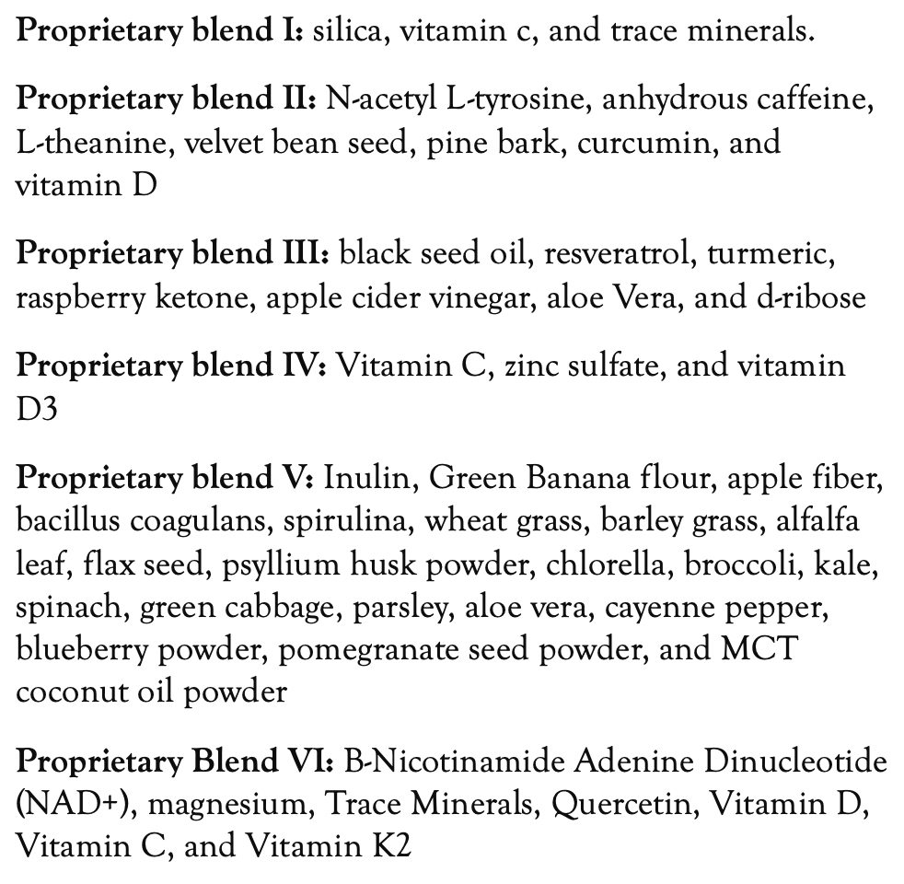
Method
PROPRIETARY BLENDS LEGEND
Proprietary blend I: 2x6 drops, morning and
evening, for 3 days, then every 3 days then
increased by 1-1 drops every 3 days to 2x12-15
Proprietary blend III: 1/2 sachet in the morning
for 3 days then 1 sachet in the morning for 3 days then 1 sachet in the morning and 1 sachet in the evening for 3 days, then 2 sachet in the morning and 1 sachet in the evening
Proprietary blend IV: 1 teaspoon in the
morning
Proprietary blend V: 1 teaspoon in the
in the evening for 3 days, then 1 teaspoon in the morning and 1 teaspoon in the evening
Proprietary blend VI: 2 in the
morning and 2 in the evening

Slide 13
Additional Proposal
She couldn't have a special diet because she couldn't eat anything!
Exercises to achieve a positive mental and emotional state (e.g: meditation, breathing exercises…)

Slide 14
Results (After 3 months of complementary therapy. She received chemotherapy treatment continuously.)
Laboratory: higher WBC (white blood cells): 15,4-10,2 (range 4,8-10,8 G/L) high inflammatory parameter CRP: 87-28 mg/l, (normal up to 5,0) and higher liver enzyme levels: ASAT:98-45 (U/L) (range 0-50), ALAT:88-38, range (0-50), GGTP: 126-70, (range 8-50 U/l)
Other control examinations (CT, PET CT) were not performed due to the palliative treatment!
Complaints have been reduced
Nausea, diarrhea have stopped.
The extreme fatigue decreased, her appetite improved, and her dyspnoea improved.
The frequency of chest pumping has decreased!
She is feeling well!
the control results are marked in red

Slide 15
References
https://www.ncbi.nlm.nih.gov/pmc/articles/PMC8046146/
https://pubmed.ncbi.nlm.nih.gov/8901854/
https://www.ncbi.nlm.nih.gov/pmc/articles/PMC3252704/
https://www.ncbi.nlm.nih.gov/pmc/articles/PMC3787870/
https://www.ncbi.nlm.nih.gov/pmc/articles/PMC5119971/
https://www.sciencedirect.com/science/article/pii/S0167488917301696

Slide 16
Thank You for Joining Us This Week!!

